Slide 1
A4
Annie Ross

Slide 2
Exploring Features

Slide 3
1D
Jon’s Gestures

Slide 4
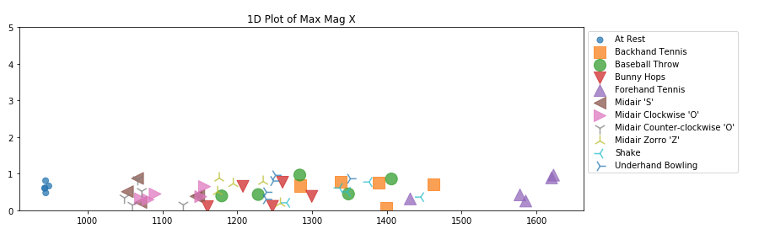
Max of Magnitude

Slide 5
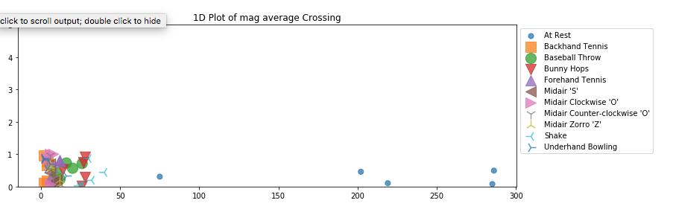
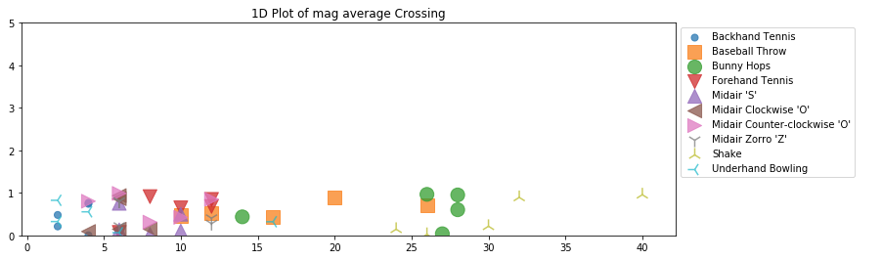
Mag # Of Crossing Mean Value since mag doesn’t have zero crossings, tried a mean crossing.
With at Rest removed

Slide 6
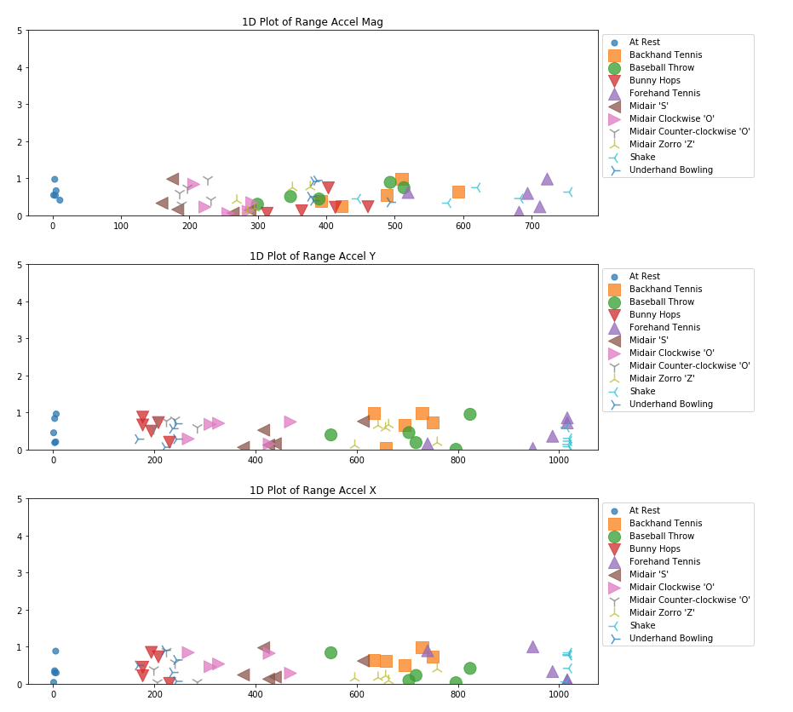
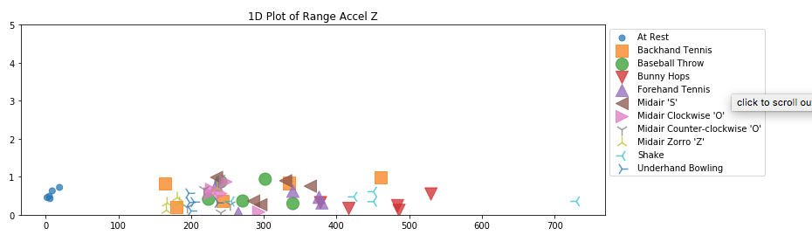
Range of Mag, Y, X, and Z

Slide 7
2D
Jon’s Gestures

Slide 8
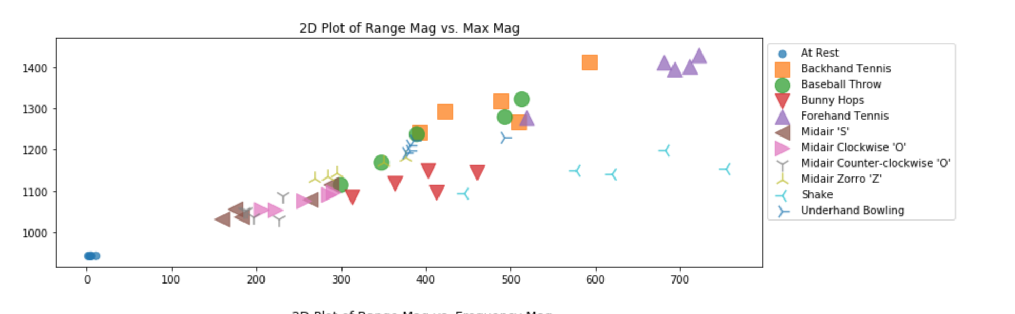
Range of Mag vs Max Mag

Slide 9
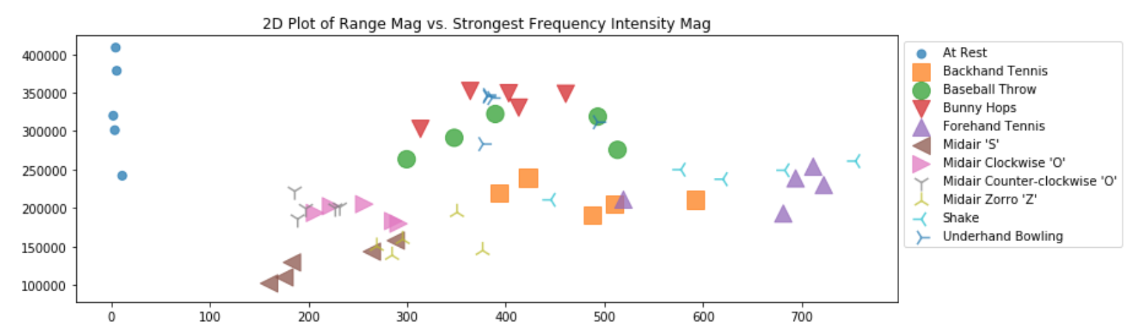
Magnitude Range vs Strongest Frequency Intensity

Slide 10
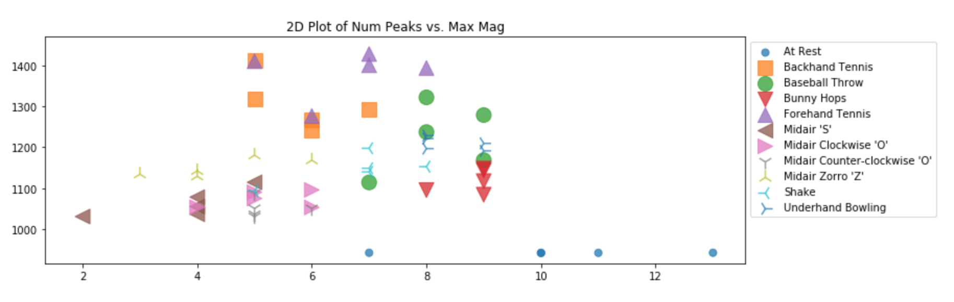
Magnitude Number of Peaks vs Max

Slide 11
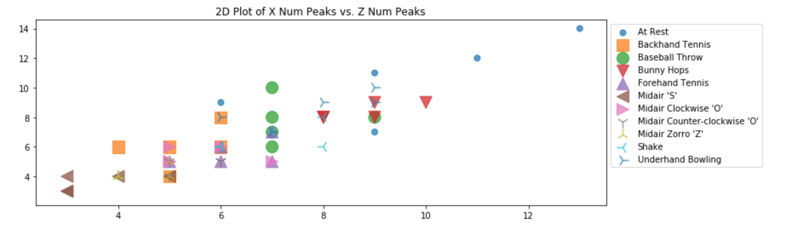
X Num Peaks vs Z Num Peaks

Slide 12
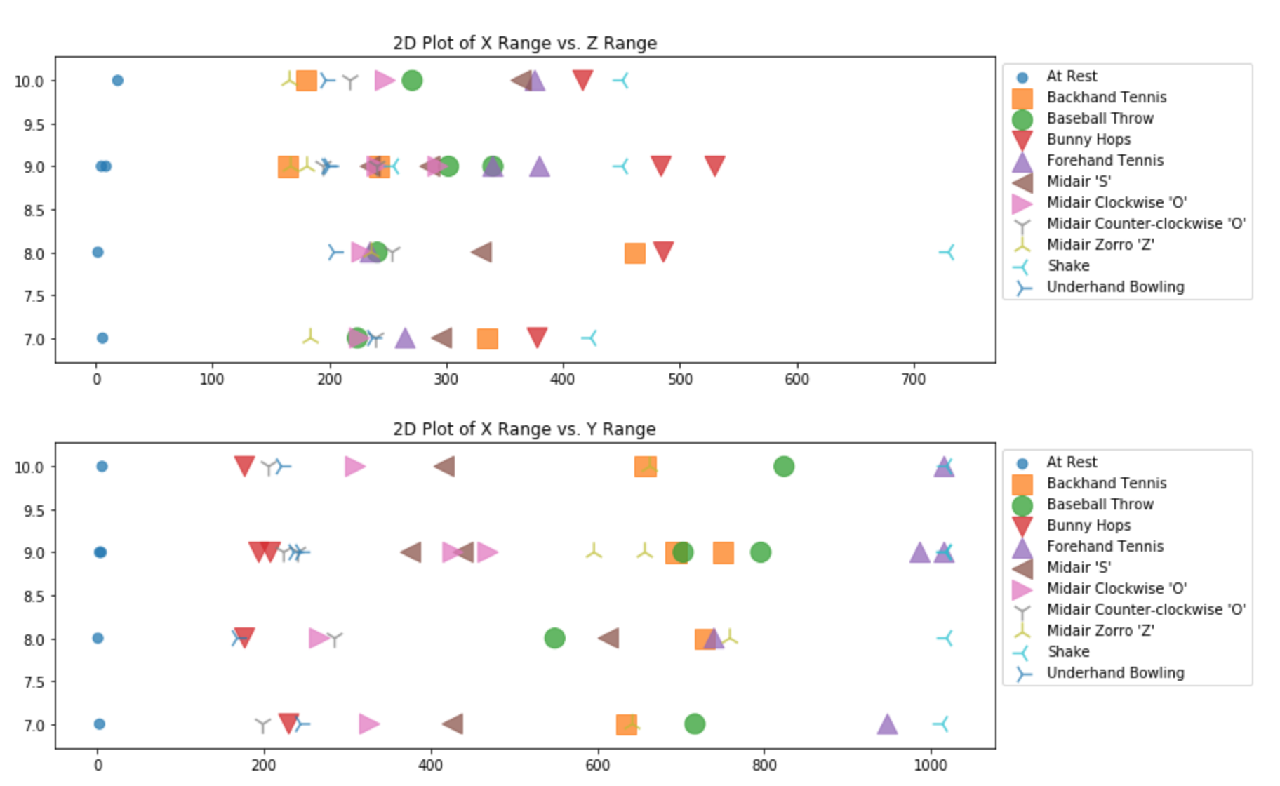
X, Y, and Z ranges

Slide 13
Applying Models

Slide 14
Jon’s Gestures

Slide 15
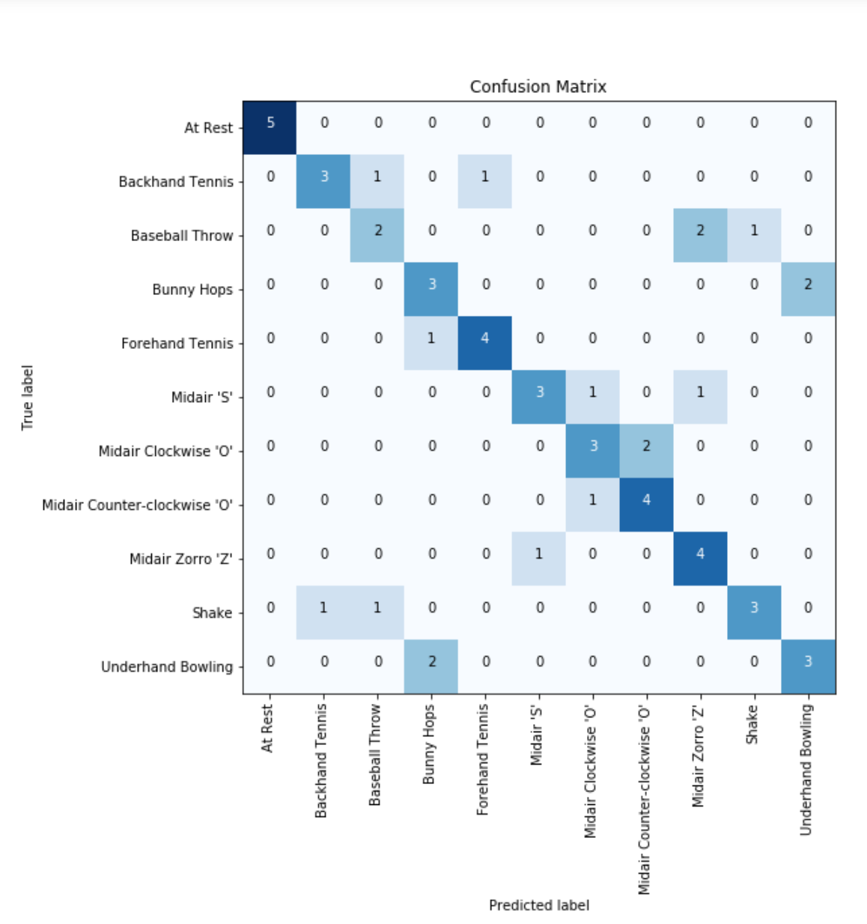
SVM, linear
Features: Mag range, mean mag
At Rest: 5/5 (100.0%)
Backhand Tennis: 3/5 (60.0%)
Baseball Throw: 2/5 (40.0%)
Bunny Hops: 3/5 (60.0%)
Forehand Tennis: 4/5 (80.0%)
Midair 'S': 3/5 (60.0%)
Midair Clockwise 'O': 3/5 (60.0%)
Midair Counter-clockwise 'O': 4/5 (80.0%)
Midair Zorro 'Z': 4/5 (80.0%)
Shake: 3/5 (60.0%)
Underhand Bowling: 3/5 (60.0%)
Total classifier accuracy 67.27%

Slide 16
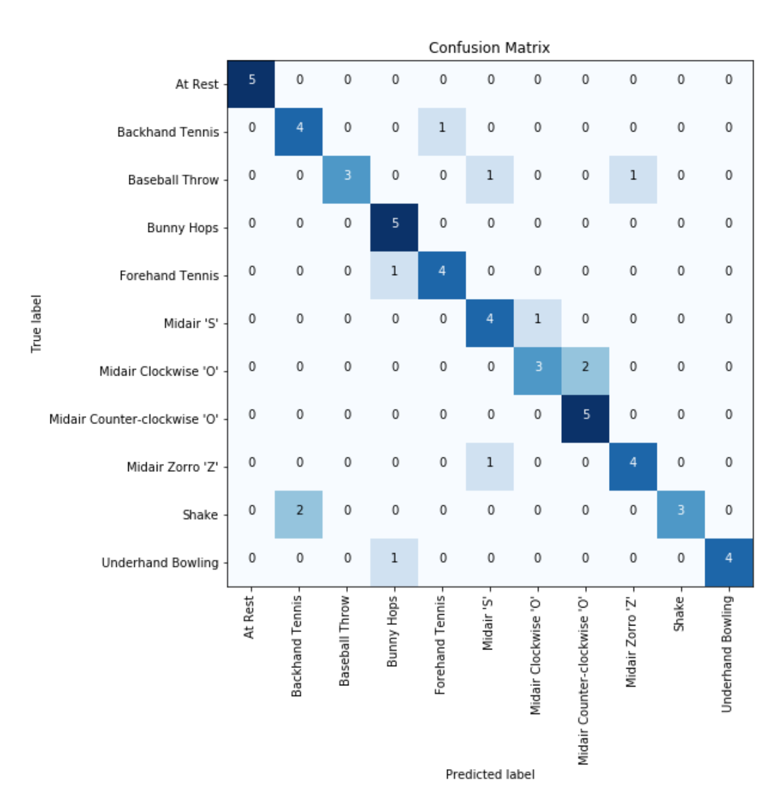
SVM, linear
Features: Mag range, mean mag, mag std
At Rest: 5/5 (100.0%)
Backhand Tennis: 4/5 (80.0%)
Baseball Throw: 3/5 (60.0%)
Bunny Hops: 5/5 (100.0%)
Forehand Tennis: 4/5 (80.0%)
Midair 'S': 4/5 (80.0%)
Midair Clockwise 'O': 3/5 (60.0%)
Midair Counter-clockwise 'O': 5/5 (100.0%)
Midair Zorro 'Z': 4/5 (80.0%)
Shake: 3/5 (60.0%)
Underhand Bowling: 4/5 (80.0%)
Total classifier accuracy 80.00%

Slide 17
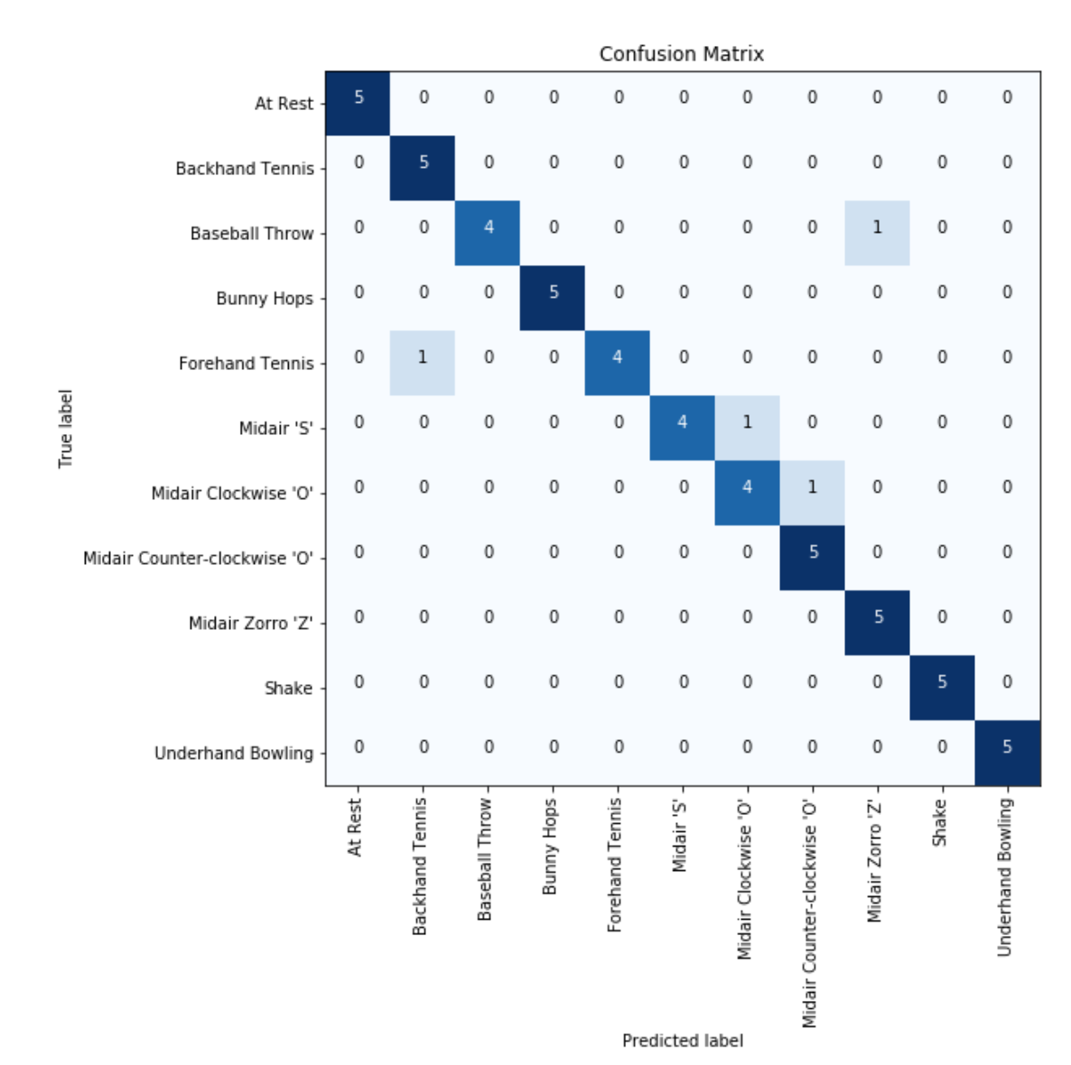
SVM, linear
Features: Mag range, x range, y range, z range, mean mag, mag std
At Rest: 5/5 (100.0%)
Backhand Tennis: 5/5 (100.0%)
Baseball Throw: 4/5 (80.0%)
Bunny Hops: 5/5 (100.0%)
Forehand Tennis: 4/5 (80.0%)
Midair 'S': 4/5 (80.0%)
Midair Clockwise 'O': 4/5 (80.0%)
Midair Counter-clockwise 'O': 5/5 (100.0%)
Midair Zorro 'Z': 5/5 (100.0%)
Shake: 5/5 (100.0%)
Underhand Bowling: 5/5 (100.0%)
Total classifier accuracy 92.73%

Slide 18
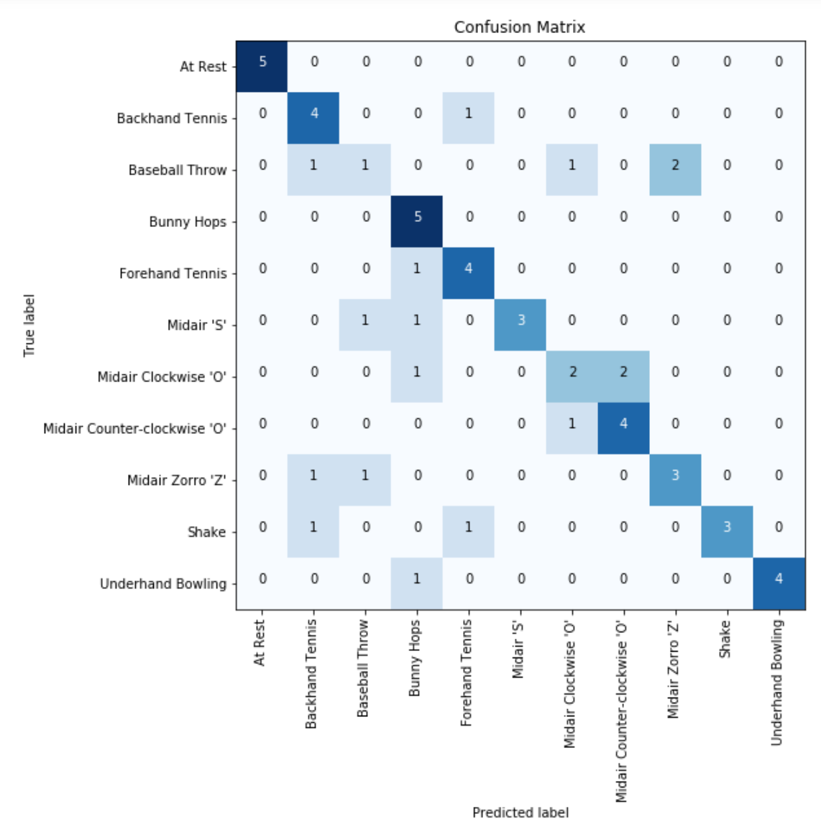
KNeighborsClassifier, n=5
Features: Mag range, mean mag, mag std
At Rest: 5/5 (100.0%)
Backhand Tennis: 4/5 (80.0%)
Baseball Throw: 1/5 (20.0%)
Bunny Hops: 5/5 (100.0%)
Forehand Tennis: 4/5 (80.0%)
Midair 'S': 3/5 (60.0%)
Midair Clockwise 'O': 2/5 (40.0%)
Midair Counter-clockwise 'O': 4/5 (80.0%)
Midair Zorro 'Z': 3/5 (60.0%)
Shake: 3/5 (60.0%)
Underhand Bowling: 4/5 (80.0%)
Total classifier accuracy 69.09%

Slide 19
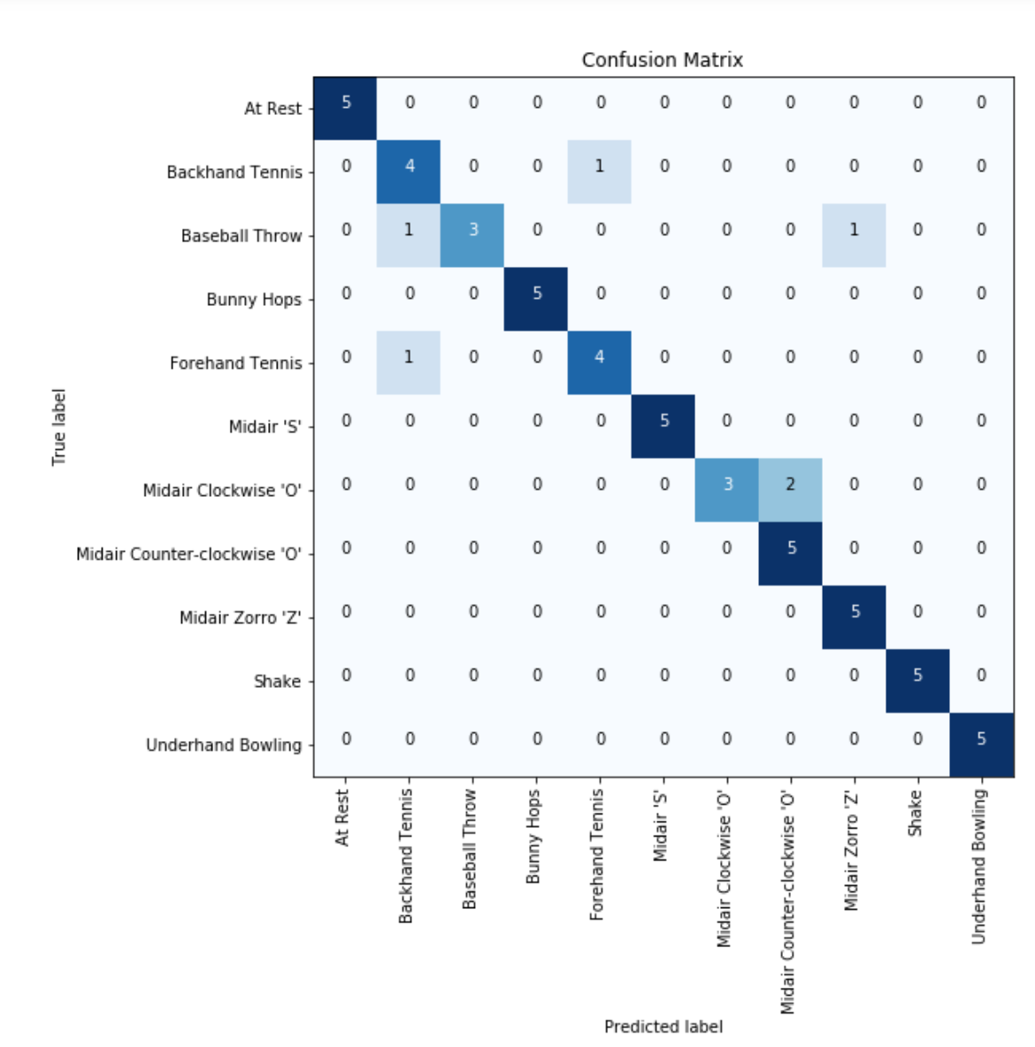
KNeighborsClassifier, n=5
Features: Mag range, x range, y range, z range, mean mag, mag std
At Rest: 5/5 (100.0%)
Backhand Tennis: 4/5 (80.0%)
Baseball Throw: 3/5 (60.0%)
Bunny Hops: 5/5 (100.0%)
Forehand Tennis: 4/5 (80.0%)
Midair 'S': 5/5 (100.0%)
Midair Clockwise 'O': 3/5 (60.0%)
Midair Counter-clockwise 'O': 5/5 (100.0%)
Midair Zorro 'Z': 5/5 (100.0%)
Shake: 5/5 (100.0%)
Underhand Bowling: 5/5 (100.0%)
Total classifier accuracy 89.09%

Slide 20
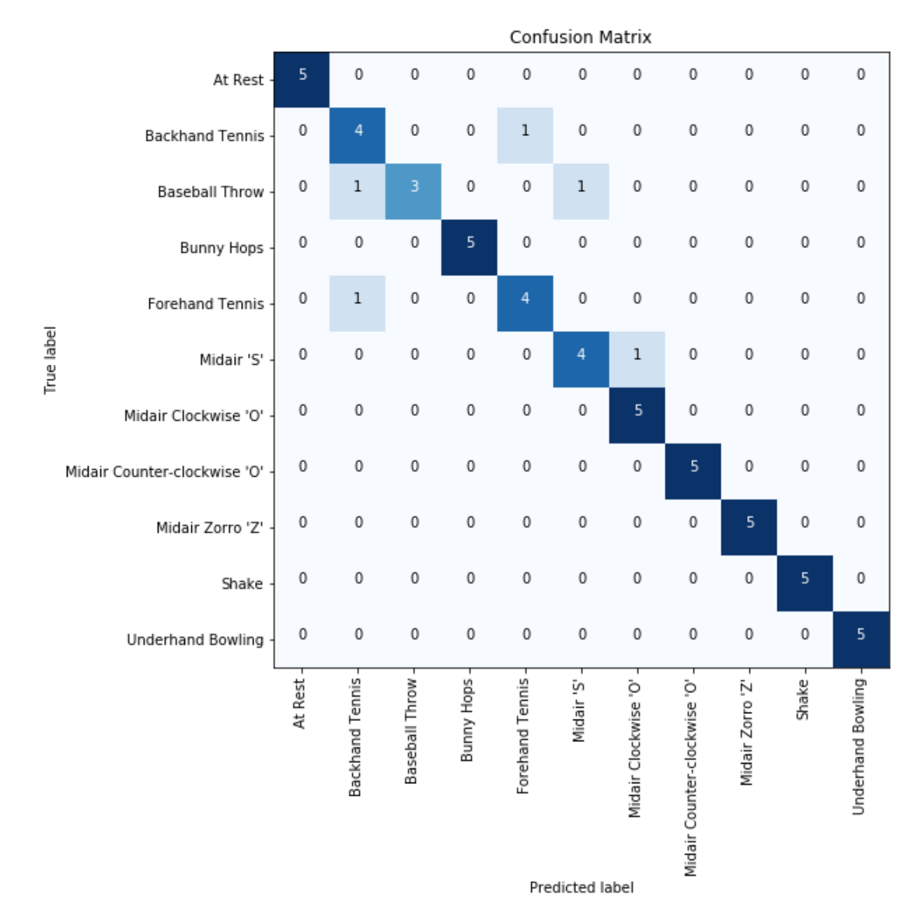
KNeighborsClassifier, n=3
Features: Mag range, x range, y range, z range, mean mag, mag std
At Rest: 5/5 (100.0%)
Backhand Tennis: 4/5 (80.0%)
Baseball Throw: 3/5 (60.0%)
Bunny Hops: 5/5 (100.0%)
Forehand Tennis: 4/5 (80.0%)
Midair 'S': 4/5 (80.0%)
Midair Clockwise 'O': 5/5 (100.0%)
Midair Counter-clockwise 'O': 5/5 (100.0%)
Midair Zorro 'Z': 5/5 (100.0%)
Shake: 5/5 (100.0%)
Underhand Bowling: 5/5 (100.0%)
Total classifier accuracy 90.91%

Slide 21
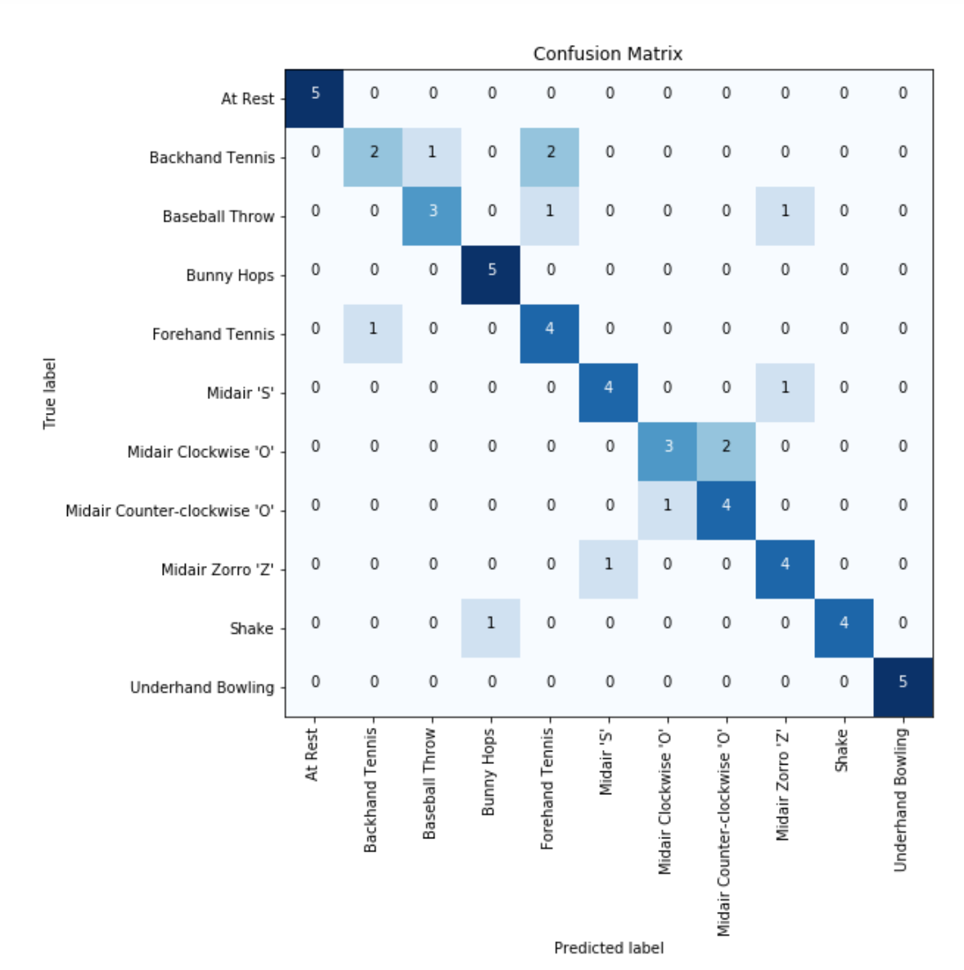
DecisionTreeClassifier
Features: Mag range, x range, y range, z range, mean mag, mag std
At Rest: 5/5 (100.0%)
Backhand Tennis: 2/5 (40.0%)
Baseball Throw: 3/5 (60.0%)
Bunny Hops: 5/5 (100.0%)
Forehand Tennis: 4/5 (80.0%)
Midair 'S': 4/5 (80.0%)
Midair Clockwise 'O': 3/5 (60.0%)
Midair Counter-clockwise 'O': 4/5 (80.0%)
Midair Zorro 'Z': 4/5 (80.0%)
Shake: 4/5 (80.0%)
Underhand Bowling: 5/5 (100.0%)
Total classifier accuracy 78.18%

Slide 22
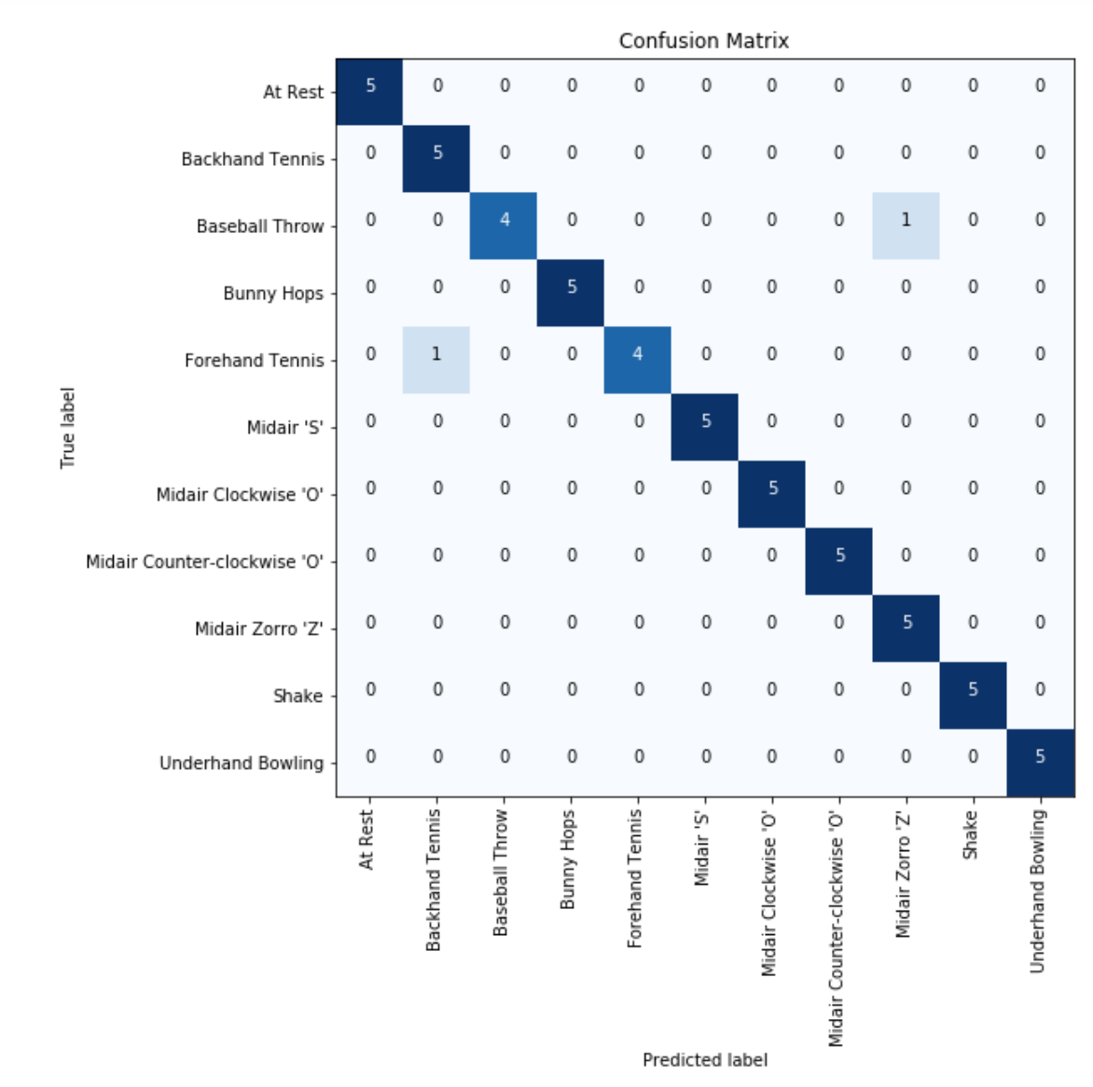
MLPClassifier,
Features: Mag range, x range, y range, z range, mean mag, mag std
At Rest: 5/5 (100.0%)
Backhand Tennis: 5/5 (100.0%)
Baseball Throw: 4/5 (80.0%)
Bunny Hops: 5/5 (100.0%)
Forehand Tennis: 4/5 (80.0%)
Midair 'S': 5/5 (100.0%)
Midair Clockwise 'O': 5/5 (100.0%)
Midair Counter-clockwise 'O': 5/5 (100.0%)
Midair Zorro 'Z': 5/5 (100.0%)
Shake: 5/5 (100.0%)
Underhand Bowling: 5/5 (100.0%)
Total classifier accuracy 96.36%

Slide 23
Annie’s Gestures

Slide 24
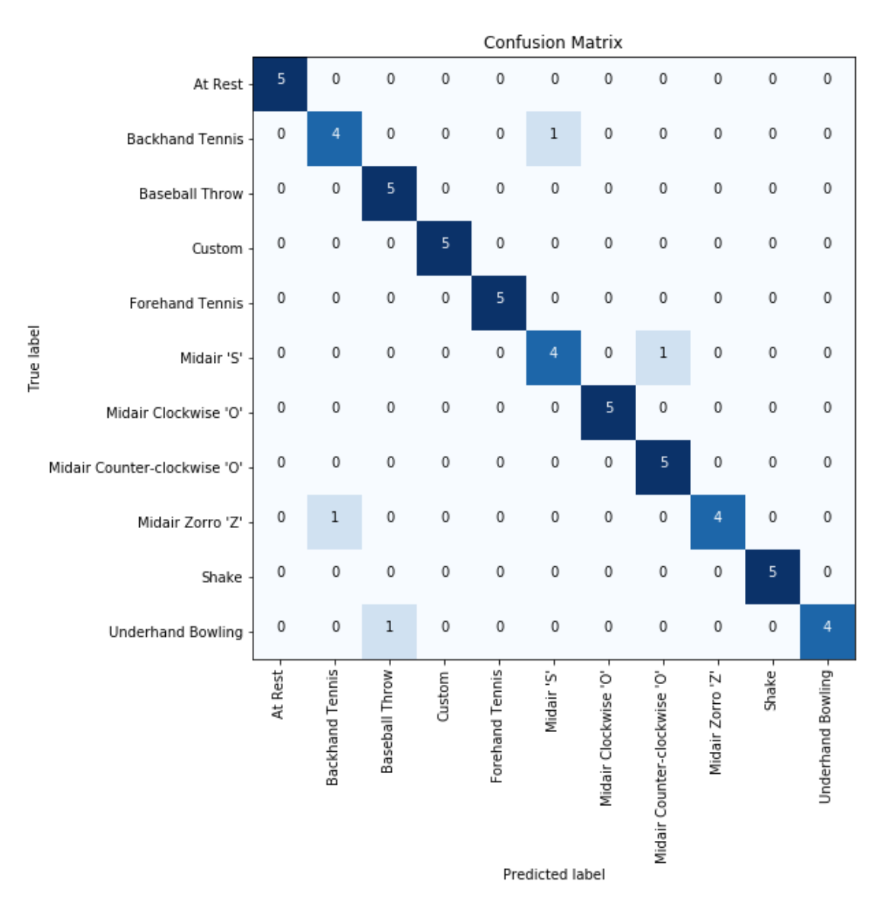
MLPClassifier,
Features: Mag range, x range, y range, z range, mean mag, mag std
At Rest: 5/5 (100.0%)
Backhand Tennis: 4/5 (80.0%)
Baseball Throw: 5/5 (100.0%)
Custom: 5/5 (100.0%)
Forehand Tennis: 5/5 (100.0%)
Midair 'S': 4/5 (80.0%)
Midair Clockwise 'O': 5/5 (100.0%)
Midair Counter-clockwise 'O': 5/5 (100.0%)
Midair Zorro 'Z': 4/5 (80.0%)
Shake: 5/5 (100.0%)
Underhand Bowling: 4/5 (80.0%)
Total classifier accuracy 92.73%

Slide 25
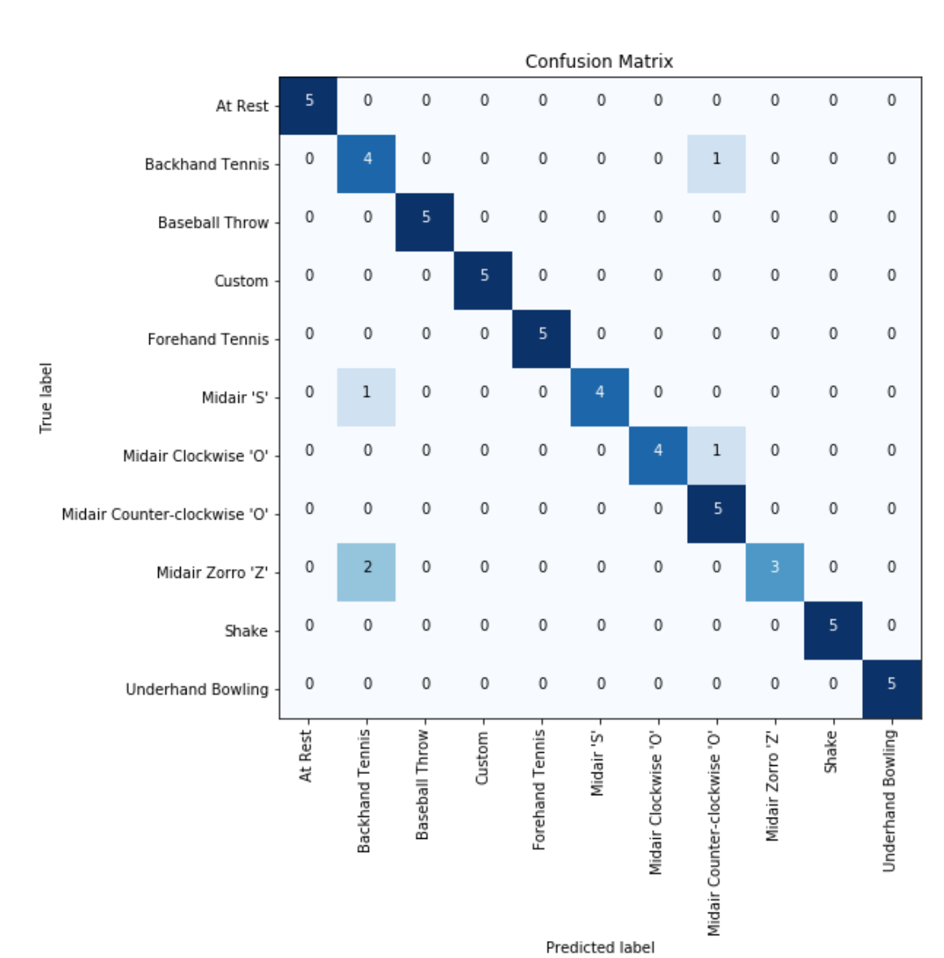
KNeighborsClassifier, n=3
Features: Mag range, x range, y range, z range, mean mag, mag std
At Rest: 5/5 (100.0%)
Backhand Tennis: 4/5 (80.0%)
Baseball Throw: 5/5 (100.0%)
Custom: 5/5 (100.0%)
Forehand Tennis: 5/5 (100.0%)
Midair 'S': 4/5 (80.0%)
Midair Clockwise 'O': 4/5 (80.0%)
Midair Counter-clockwise 'O': 5/5 (100.0%)
Midair Zorro 'Z': 3/5 (60.0%)
Shake: 5/5 (100.0%)
Underhand Bowling: 5/5 (100.0%)
Total classifier accuracy 90.91%

Slide 26
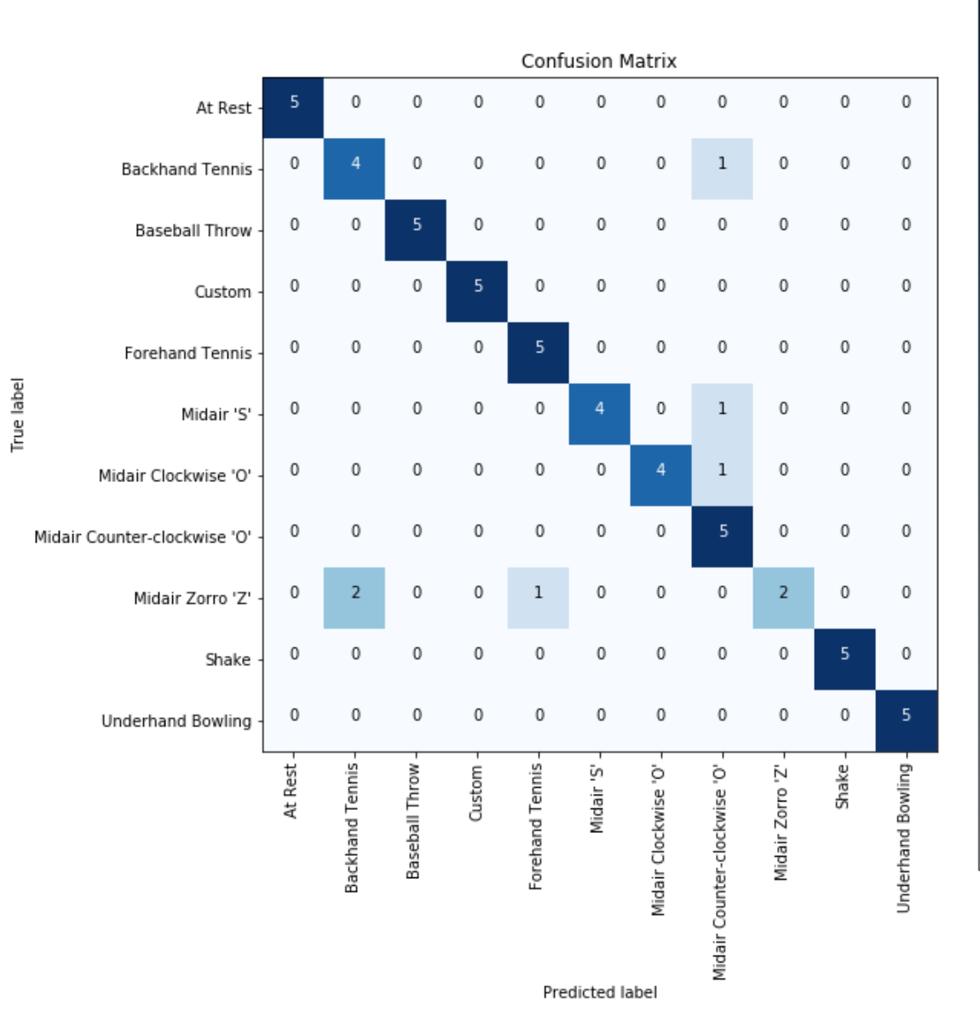
KNeighborsClassifier, n=5
Features: Mag range, x range, y range, z range, mean mag, mag std
At Rest: 5/5 (100.0%)
Backhand Tennis: 4/5 (80.0%)
Baseball Throw: 5/5 (100.0%)
Custom: 5/5 (100.0%)
Forehand Tennis: 5/5 (100.0%)
Midair 'S': 4/5 (80.0%)
Midair Clockwise 'O': 4/5 (80.0%)
Midair Counter-clockwise 'O': 5/5 (100.0%)
Midair Zorro 'Z': 2/5 (40.0%)
Shake: 5/5 (100.0%)
Underhand Bowling: 5/5 (100.0%)
Total classifier accuracy 89.09%

Slide 27
Generalizing
Using MLPClassifier

Slide 28
Train on all of Jon’s Test on 1 fold of Annie’s

Slide 29
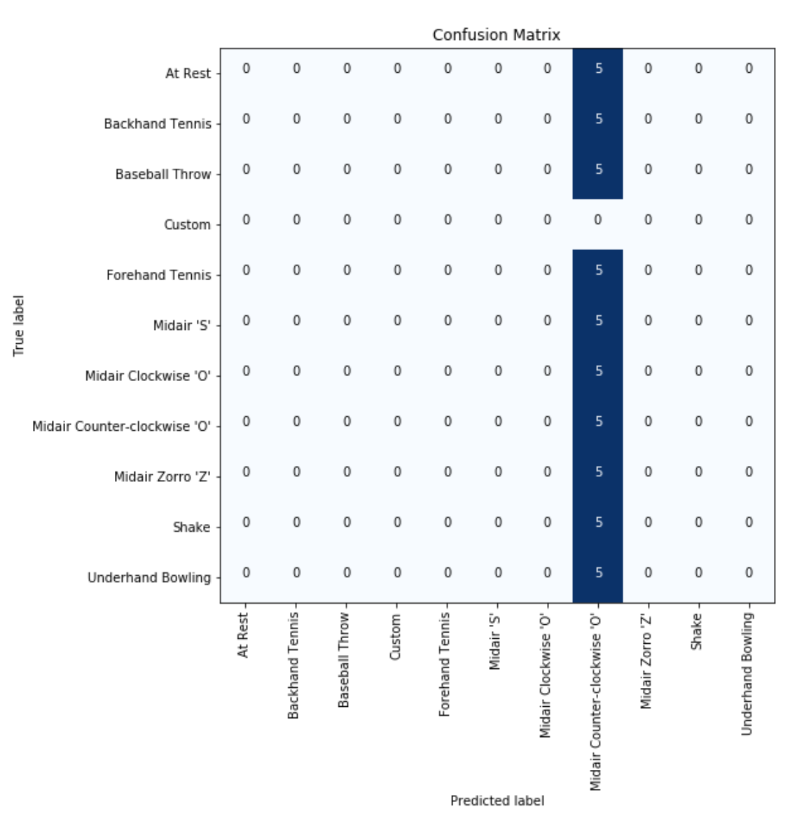
MLPClassifier
Features: Mag range, x range, y range, z range, mean mag, mag std
At Rest: 0/5 (0.0%)
Backhand Tennis: 0/5 (0.0%)
Baseball Throw: 0/5 (0.0%)
Custom: 0/5 (0.0%)
Forehand Tennis: 0/5 (0.0%)
Midair 'S': 0/5 (0.0%)
Midair Clockwise 'O': 0/5 (0.0%)
Midair Counter-clockwise 'O': 5/5 (100.0%)
Midair Zorro 'Z': 0/5 (0.0%)
Shake: 0/5 (0.0%)
Underhand Bowling: 0/5 (0.0%)
Total classifier accuracy 9.09%

Slide 30
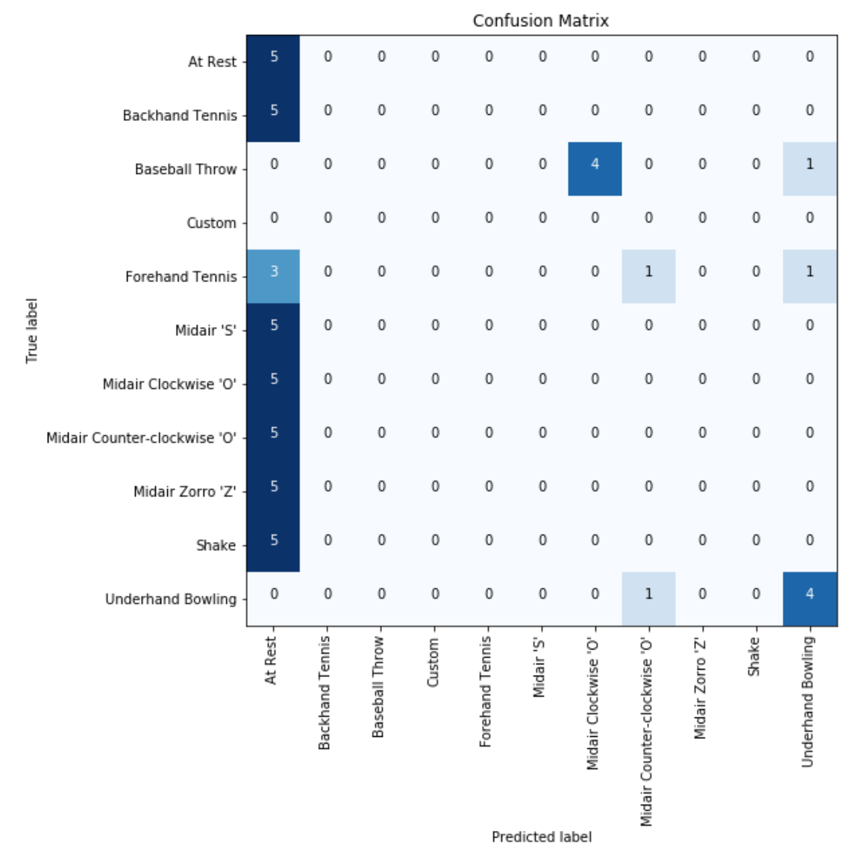
SVM, linear
Features: Mag range, x range, y range, z range, mean mag,
At Rest: 5/5 (100.0%)
Backhand Tennis: 0/5 (0.0%)
Baseball Throw: 0/5 (0.0%)
Custom: 0/5 (0.0%)
Forehand Tennis: 0/5 (0.0%)
Midair 'S': 0/5 (0.0%)
Midair Clockwise 'O': 0/5 (0.0%)
Midair Counter-clockwise 'O': 0/5 (0.0%)
Midair Zorro 'Z': 0/5 (0.0%)
Shake: 0/5 (0.0%)
Underhand Bowling: 4/5 (80.0%)
Total classifier accuracy 16.36%

Slide 31
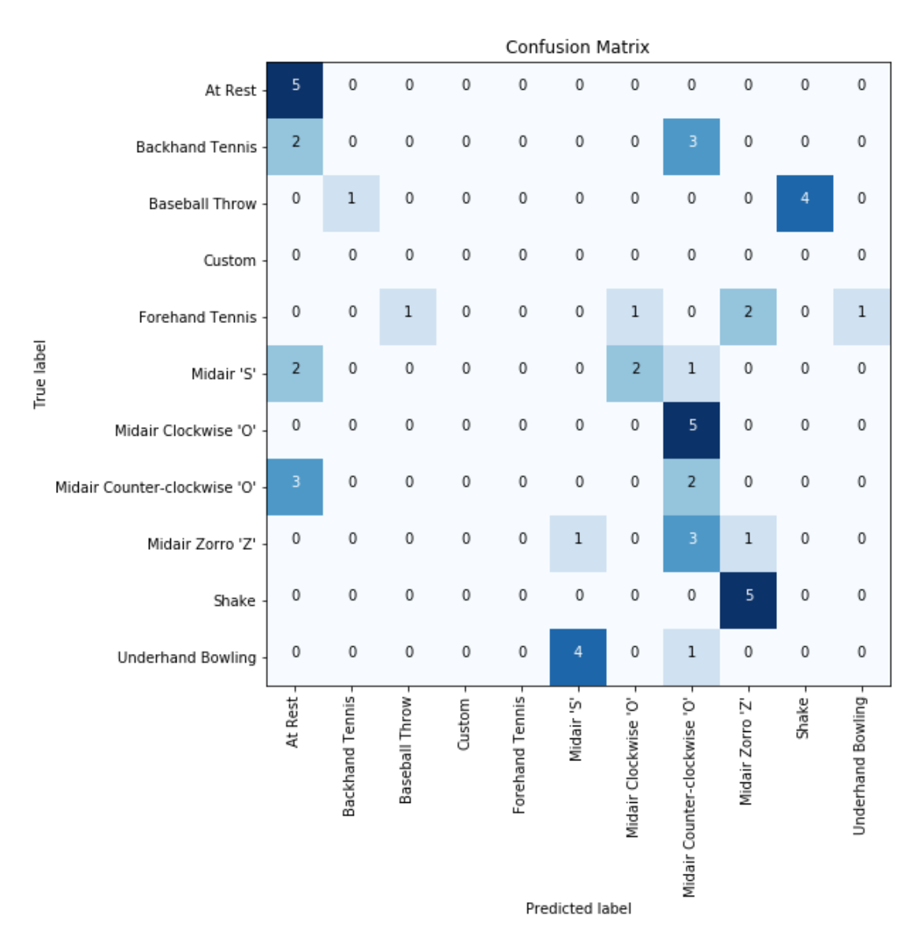
KNeighborsClassifier, k=5
Features: x range, y range, z range,
At Rest: 5/5 (100.0%)
Backhand Tennis: 0/5 (0.0%)
Baseball Throw: 0/5 (0.0%)
Custom: 0/5 (0.0%)
Forehand Tennis: 0/5 (0.0%)
Midair 'S': 0/5 (0.0%)
Midair Clockwise 'O': 0/5 (0.0%)
Midair Counter-clockwise 'O': 2/5 (40.0%)
Midair Zorro 'Z': 1/5 (20.0%)
Shake: 0/5 (0.0%)
Underhand Bowling: 0/5 (0.0%)
Total classifier accuracy 14.55%

Slide 32
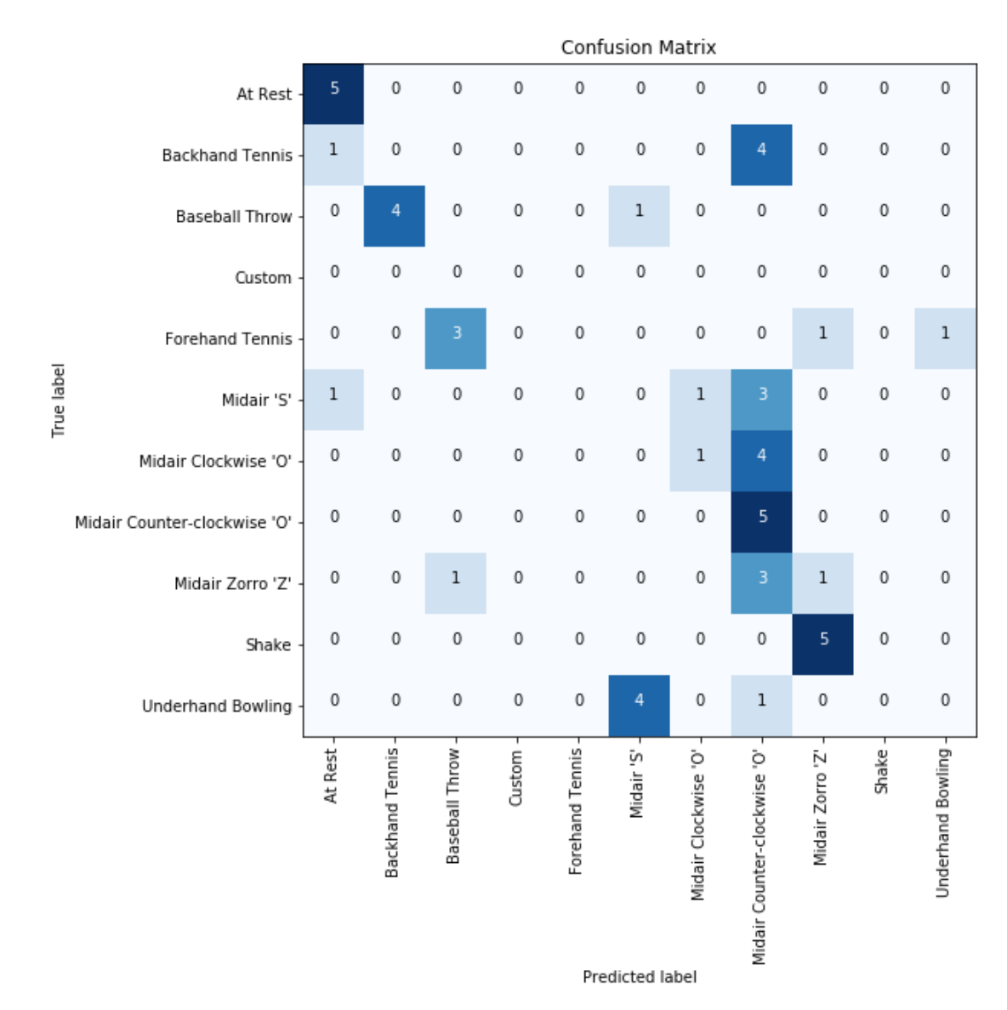
KNeighborsClassifier, k=3
Features: x range, y range, z range,
At Rest: 5/5 (100.0%)
Backhand Tennis: 0/5 (0.0%)
Baseball Throw: 0/5 (0.0%)
Custom: 0/5 (0.0%)
Forehand Tennis: 0/5 (0.0%)
Midair 'S': 0/5 (0.0%)
Midair Clockwise 'O': 1/5 (20.0%)
Midair Counter-clockwise 'O': 5/5 (100.0%)
Midair Zorro 'Z': 1/5 (20.0%)
Shake: 0/5 (0.0%)
Underhand Bowling: 0/5 (0.0%)
Total classifier accuracy 21.82%

Slide 33
Train on all of Annie’s Test on 1 fold of Jon’s

Slide 34
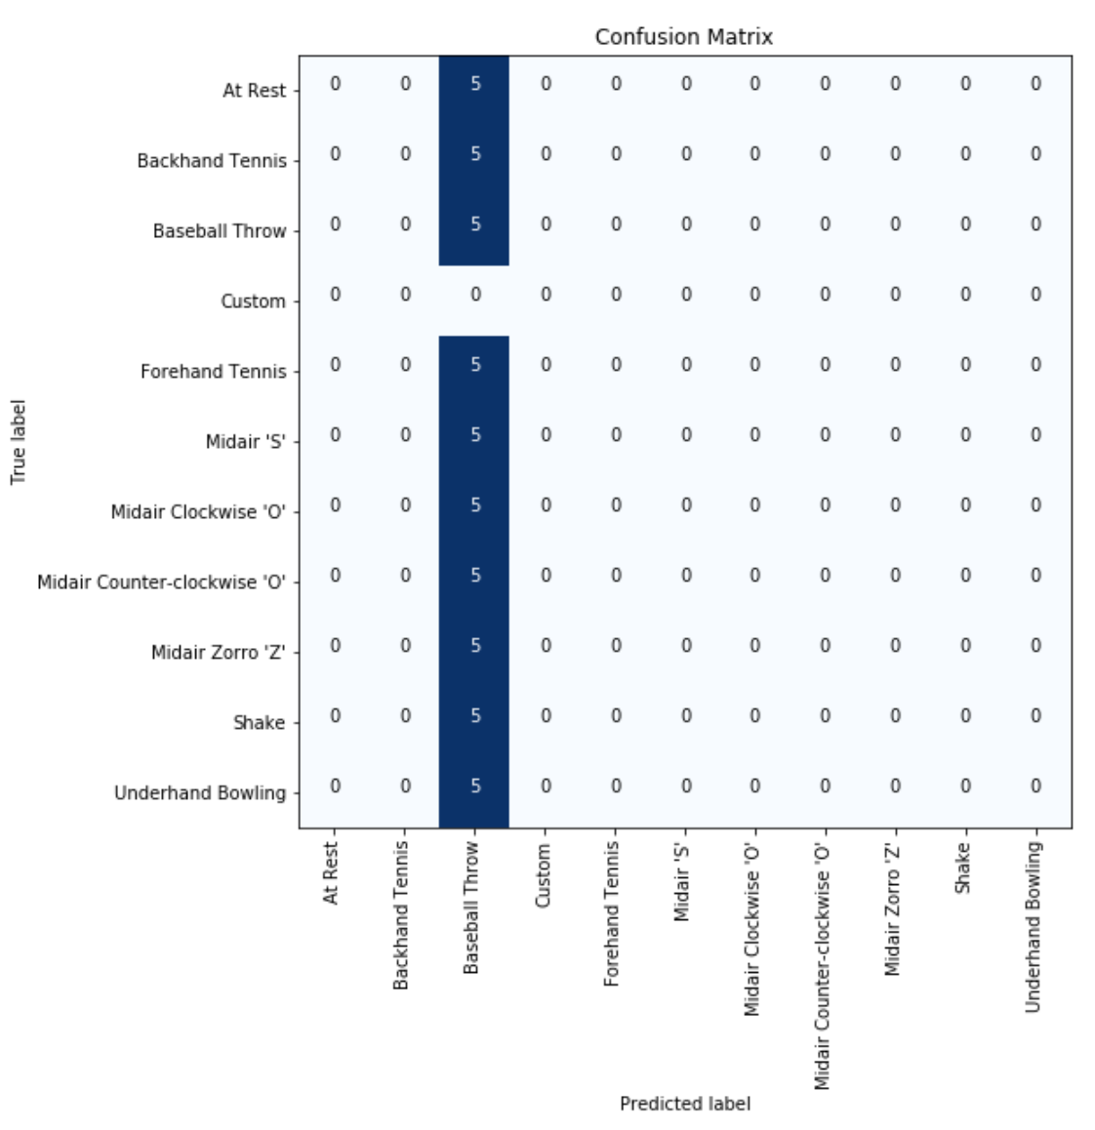
SVM, linear
Features: x range, y range, z range, mag range,
mag mean, mag sd
At Rest: 0/5 (0.0%)
Backhand Tennis: 0/5 (0.0%)
Baseball Throw: 5/5 (100.0%)
Custom: 0/5 (0.0%)
Forehand Tennis: 0/5 (0.0%)
Midair 'S': 0/5 (0.0%)
Midair Clockwise 'O': 0/5 (0.0%)
Midair Counter-clockwise 'O': 0/5 (0.0%)
Midair Zorro 'Z': 0/5 (0.0%)
Shake: 0/5 (0.0%)
Underhand Bowling: 0/5 (0.0%)
Total classifier accuracy 9.09%

Slide 35
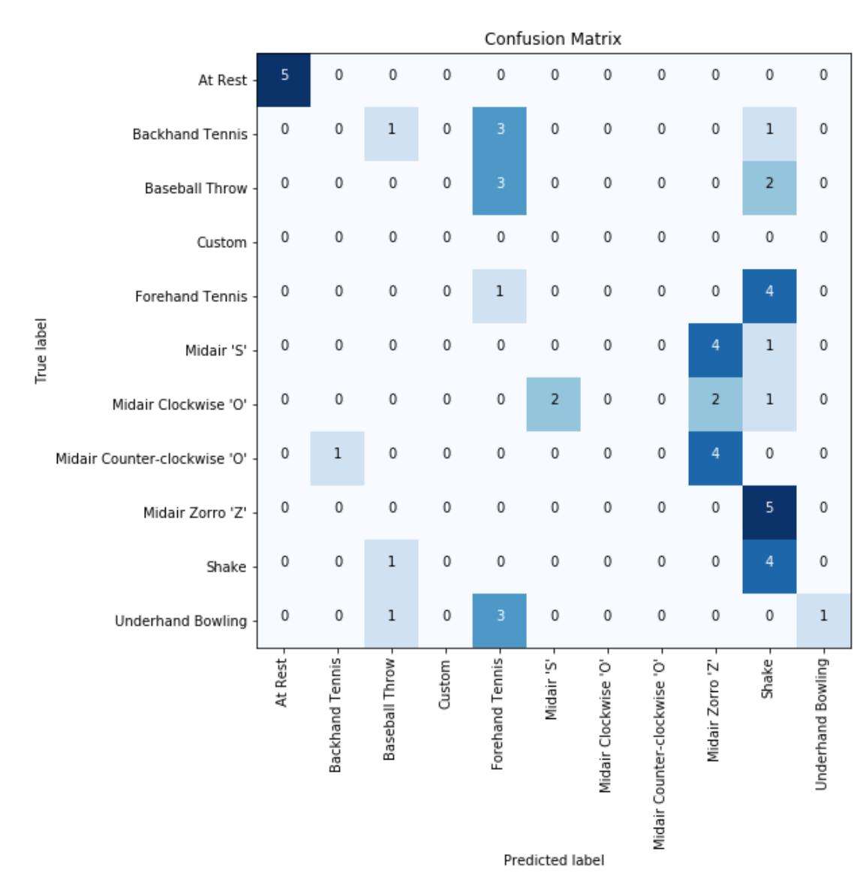
KNeighborsClassifier, k=3
Features: x range, y range, z range,
At Rest: 5/5 (100.0%)
Backhand Tennis: 0/5 (0.0%)
Baseball Throw: 0/5 (0.0%)
Custom: 0/5 (0.0%)
Forehand Tennis: 1/5 (20.0%)
Midair 'S': 0/5 (0.0%)
Midair Clockwise 'O': 0/5 (0.0%)
Midair Counter-clockwise 'O': 0/5 (0.0%)
Midair Zorro 'Z': 0/5 (0.0%)
Shake: 4/5 (80.0%)
Underhand Bowling: 1/5 (20.0%)
Total classifier accuracy 20.00%

Slide 36
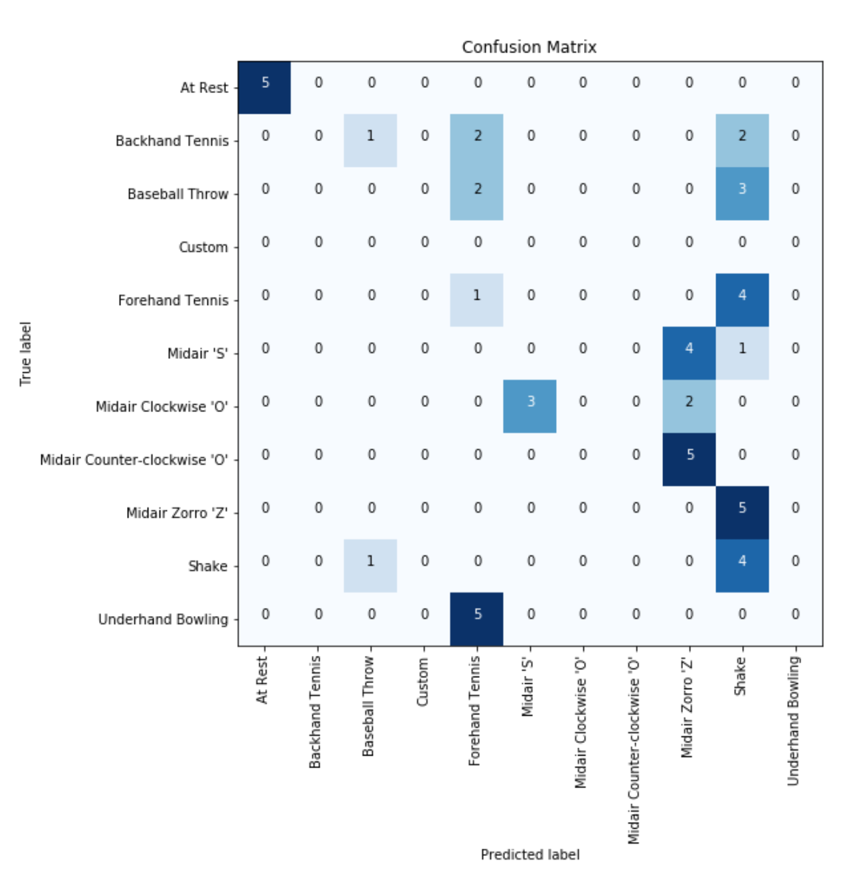
KNeighborsClassifier, k=5
Features: x range, y range, z range,
At Rest: 5/5 (100.0%)
Backhand Tennis: 0/5 (0.0%)
Baseball Throw: 0/5 (0.0%)
Custom: 0/5 (0.0%)
Forehand Tennis: 1/5 (20.0%)
Midair 'S': 0/5 (0.0%)
Midair Clockwise 'O': 0/5 (0.0%)
Midair Counter-clockwise 'O': 0/5 (0.0%)
Midair Zorro 'Z': 0/5 (0.0%)
Shake: 4/5 (80.0%)
Underhand Bowling: 0/5 (0.0%)
Total classifier accuracy 18.18%

Slide 37
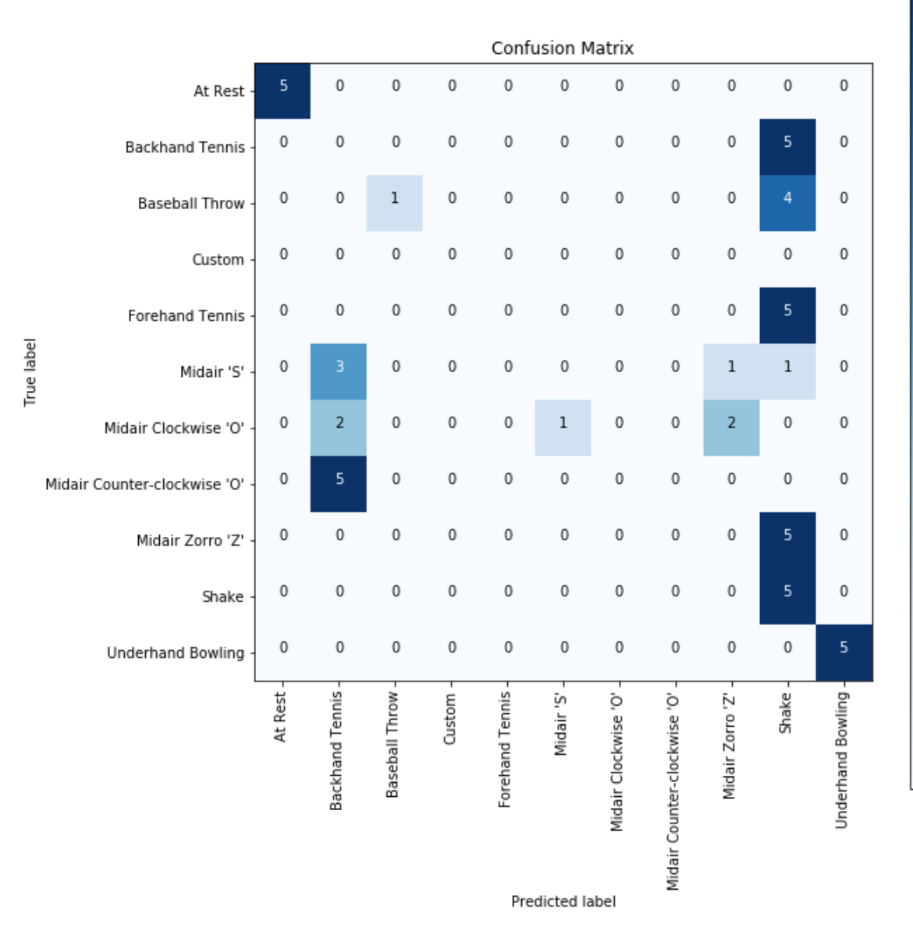
KNeighborsClassifier, k=5
Features: x range, y range, mag range,
At Rest: 5/5 (100.0%)
Backhand Tennis: 0/5 (0.0%)
Baseball Throw: 1/5 (20.0%)
Custom: 0/5 (0.0%)
Forehand Tennis: 0/5 (0.0%)
Midair 'S': 0/5 (0.0%)
Midair Clockwise 'O': 0/5 (0.0%)
Midair Counter-clockwise 'O': 0/5 (0.0%)
Midair Zorro 'Z': 0/5 (0.0%)
Shake: 5/5 (100.0%)
Underhand Bowling: 5/5 (100.0%)
Total classifier accuracy 29.09%

Slide 38
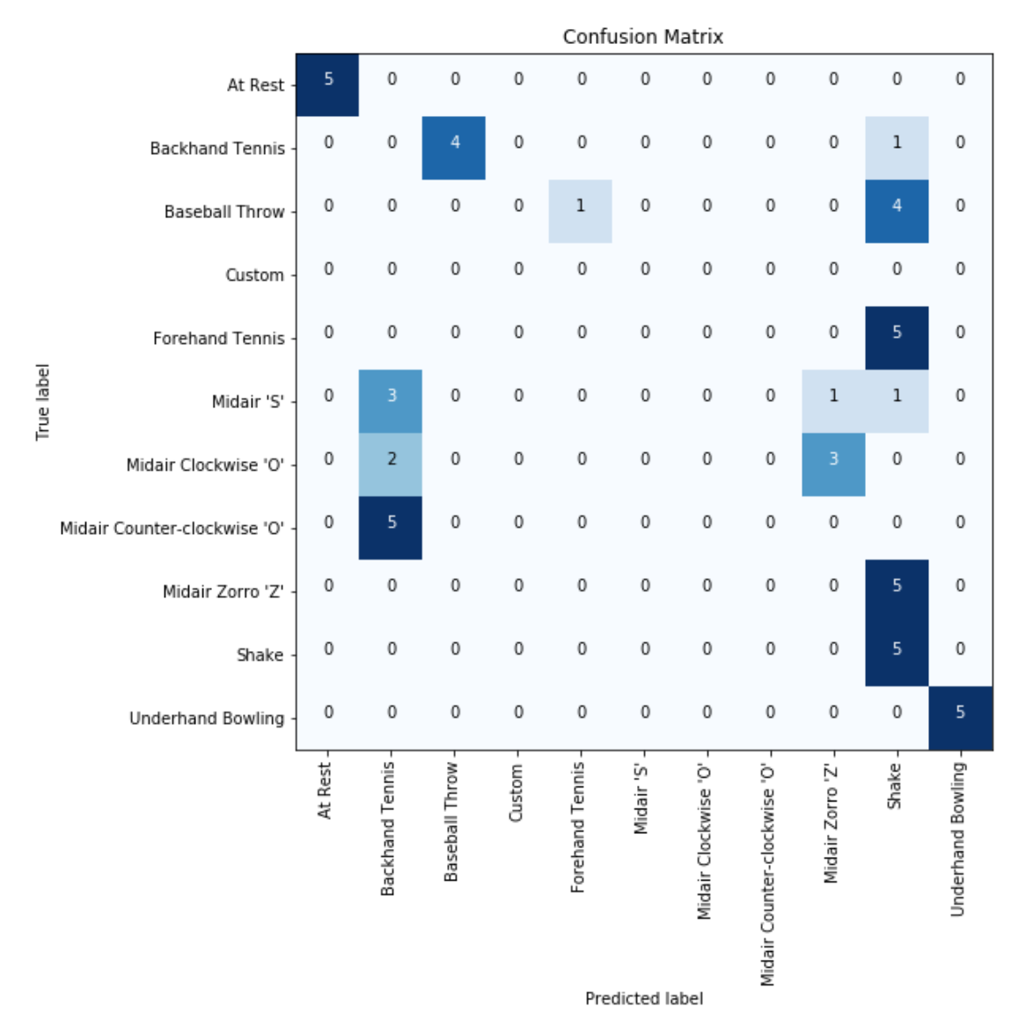
SVM, linear
Features: x range, y range, mag range,
At Rest: 5/5 (100.0%)
Backhand Tennis: 0/5 (0.0%)
Baseball Throw: 0/5 (0.0%)
Custom: 0/5 (0.0%)
Forehand Tennis: 0/5 (0.0%)
Midair 'S': 0/5 (0.0%)
Midair Clockwise 'O': 0/5 (0.0%)
Midair Counter-clockwise 'O': 0/5 (0.0%)
Midair Zorro 'Z': 0/5 (0.0%)
Shake: 5/5 (100.0%)
Underhand Bowling: 5/5 (100.0%)
Total classifier accuracy 27.27%

Slide 39
Reflections
It appears using the full set of features that were successful for within person classification did not generalize well, suggesting the features overfit to individual people’s performance
Training with more people’s data may help generalize as it would capture more variation versus using a single person’s data to train and a single person’s to test. Adding spread and variation to training sets would give a wider range of gestures to capture

Slide 40
Impact of Training Sample Size

Slide 41
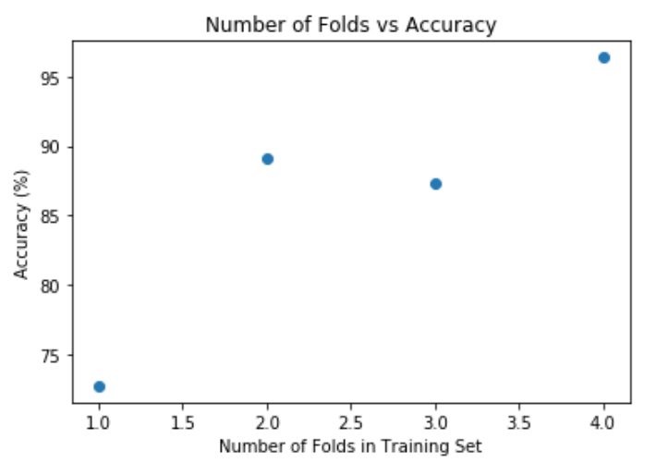
Jon’s Gestures, MLPClassifier,
Features: Mag range, x range, y range, z range, mean mag, mag std
Overall, with increased size of training set, the accuracy improved, as anticipated.
Note: I realize the x-tick marks should be whole numbers but didn’t spend time figuring out the plot function

